Slide 1











Portfolio Website
Includes
Portfolio Website:
Showcases
A website that displays a person's or an organization's work, accomplishments, abilities, and projects is called a portfolio website. It provides an internet venue for tem to showcase and market their work to the general public, employers, and prospective clients.
Skills
Creativity
Experience

Slide 2
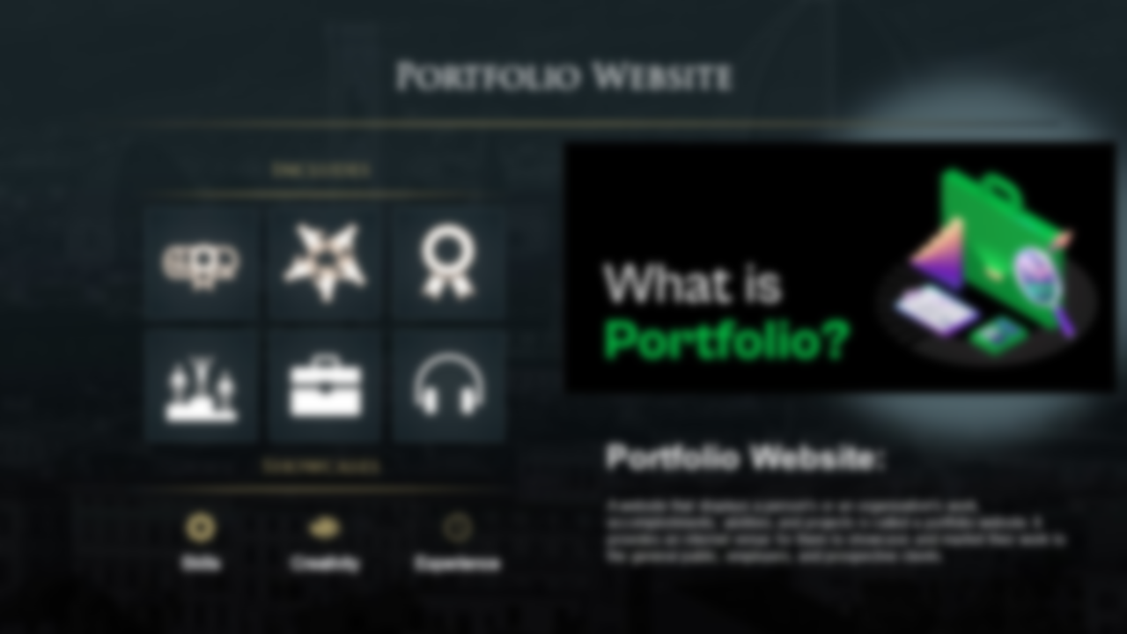
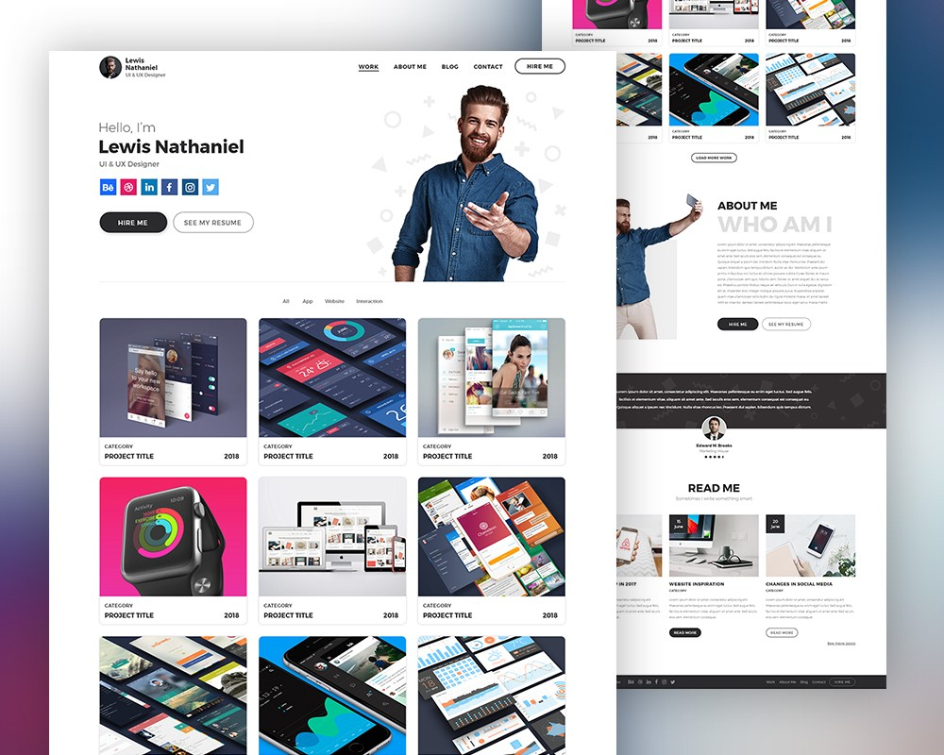
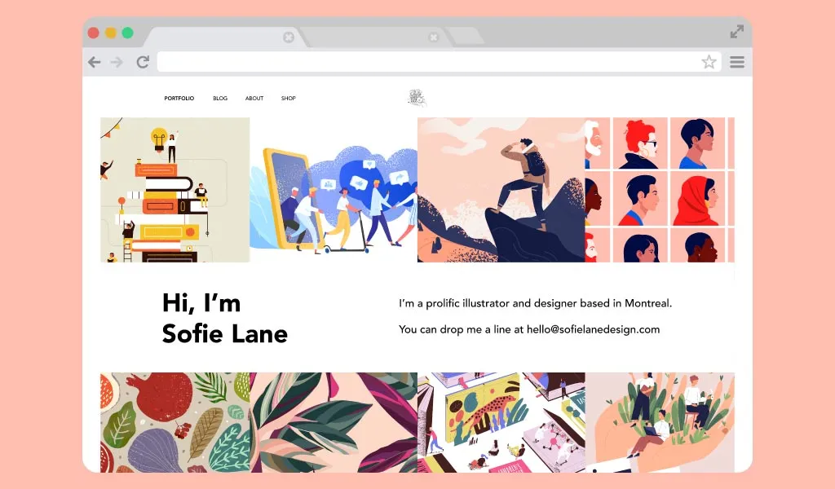
Idea
Concept
The main idea behind this website is to create a digital platform that serves as a comprehensive showcase of my work, skills, and achievements. It offers an easy-to-navigate interface for visitors to explore my projects, learn about my background, and connect with me.
The concept of my portfolio website revolves around creating a visually appealing, user-friendly, and informative online space. Using a minimalist design, clear navigation, and responsive layout, I aim to present my skills and work in a compelling and accessible manner

Slide 3

Idea
Concept
Application
The main idea behind this website is to create a digital platform that serves as a comprehensive showcase of my work, skills, and achievements. It offers an easy-to-navigate interface for visitors to explore my projects, learn about my background, and connect with me.
The concept of this website revolves around creating a visually appealing, user-friendly, and informative online space. Using a minimalist design, clear navigation, and responsive layout, I aim to present my skills and work in a compelling and accessible manner
It has practical applications for both personal and professional use. It serves as a hub for potential employers and collaborators to assess my capabilities and review my work. Additionally, it's a convenient tool for me to present my qualifications and achievements to a global audience.

Slide 4
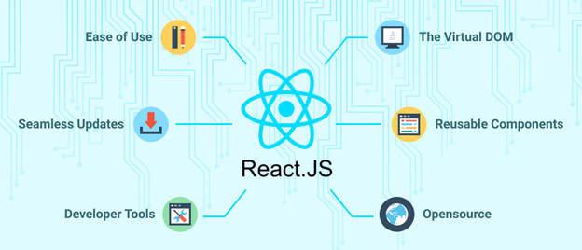
Room for improvement
Concept
Application
The concept of this website revolves around creating a visually appealing, user-friendly, and informative online space. Using a minimalist design, clear navigation, and responsive layout, I aim to present my skills and work in a compelling and accessible manner
It has practical applications for both personal and professional use. It serves as a hub for potential employers and collaborators to assess my capabilities and review my work. Additionally, it's a convenient tool for me to present my qualifications and achievements to a global audience.
Using a framework like React could enhance the user experience by allowing for real-time interactions, such as live project filtering or dynamic content loading, making the website more engaging and modern.

Slide 5
Room for improvement
Application
THANK YOU
It has practical applications for both personal and professional use. It serves as a hub for potential employers and collaborators to assess my capabilities and review my work. Additionally, it's a convenient tool for me to present my qualifications and achievements to a global audience.
Using a framework like React could enhance the user experience by allowing for real-time interactions, such as live project filtering or dynamic content loading, making the website more engaging and modern.

Slide 6

Room for improvement
THANK YOU
Using a framework like React could enhance the user experience by allowing for real-time interactions, such as live project filtering or dynamic content loading, making the website more engaging and modern.

